Slide 1
Can Teachers’ Identities Come to the Rescue in the Fourth Industrial Revolution? Prof Simon Bheki Khoza khozas@ukzn.ac.za

Slide 2
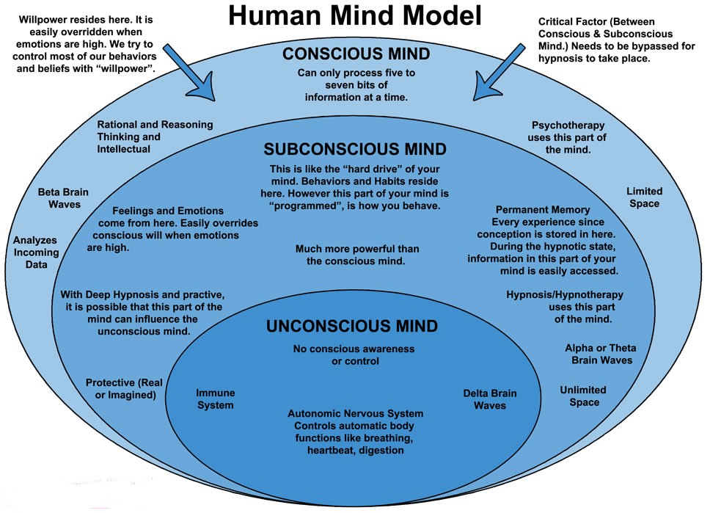

Slide 3
Research Design and Methodology
Pragmatic paradigm;
Relent style;
Purposive with Convenience sampling;
Guided analysis
Validity
Ethics.

Slide 4
Fourth Industrial Revolution (4/5IR)
Revolution is an unexpected, abrupt, unprecedented, and/or radical change that influences various sectors to perform their activities in new ways;
The 1IR (1760-1840) was characterised by the efforts of animals (communication, transportation, and production) as well as construction of railroads and the invention of the steam engine (mechanical production) (Societal identity);
The late 19th century and into the early 20th century - the 2IR - Assembly lines and Electricity (mass production) (Professional identity);
The 3IR called the computer or digital revolution started with the development of mainframe computing, the semiconductor (1960s), personal computing (1970s and 1980s), and the Internet (1990s) (Pragmatic/Personal identity);
The 4IR which began at the turn of this century was formed by the staggering confluence of emerging technology breakthroughs, covering wide-ranging fields such as artificial intelligence (AI), robotics, the internet of things (IoT), autonomous vehicles, 3D printing, nanotechnology, biotechnology, … science, energy storage and quantum computing, to name a few. COVID-19 R or 5IR towards the end of 2019 (has pushed HEIs five or ten years ahead in digitalisation) (Natural identity).

Slide 5
Migration to DC
Performance-based C = Content/Facts
Pragmatic or Personal C = Habits
Competence-based C = Outcomes/Opinions

Slide 6
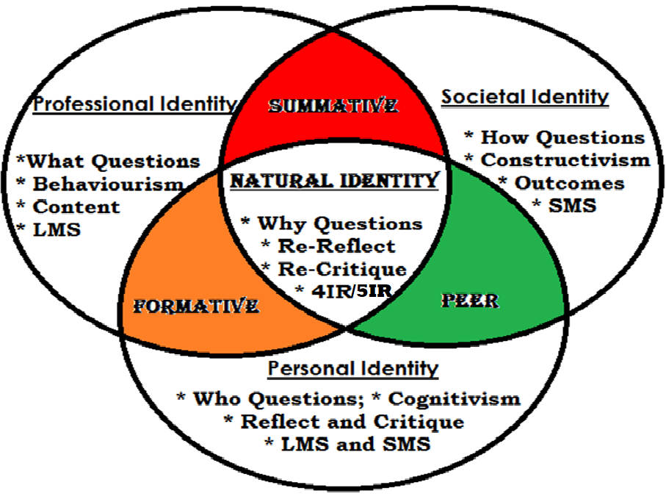
NATURAL IDENTITY

Slide 7
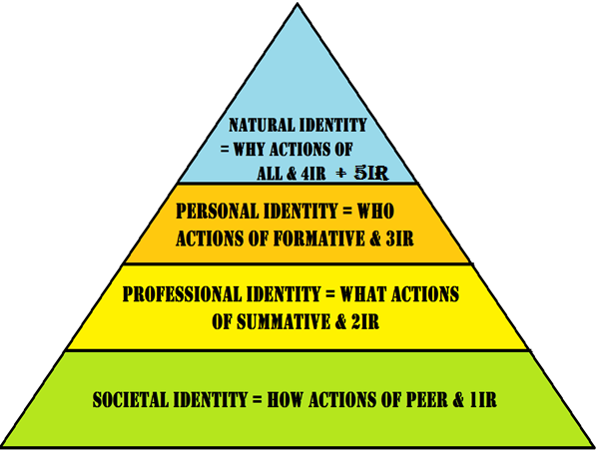
HIERARCH OF IDENTITIES

Slide 8
Currere…W Pinar
Currere offers academics and students four frames to be used in producing transformation, autobiographical, or pragmatic/personal actions.
The frames are regressive, progressive, analytical, and synthetical actions.
These four frames indicate the moments of reflection that produce actions.
A regressive moment is characterised by humans’ lived experiences to be used as data sources for the actions. Humans’ conscious minds interrogate the past subconscious mind in order to transform the humans’ mind-systems and/or mind-processes to reflect present activities.
A progressive moment is characterised by humans’ mind-imagination of the possible future. It is the imagination of what is not yet happening.
In the analytical moment, humans interrogate the future about the past, the past about the future, and the present about both the past and future.
In the synthetical moment, humans interrogate the lived present experience that reflects both the past and future experiences, in order to bring all these together to produce one meaningful action.

Slide 9
Title: An Investigation of the Number of Pretty People Found in the Pictures
Purpose: To investigate the number of pretty people found in the pictures
Quantitative question: What is the number of pretty people found in the pictures? (photo voice – Descriptive question)
Qualitative question: How does the number of pretty people presented in the pictures? (observation – Operational question)
Qualitative question: Why do the pictures have a particular number of pretty people? (semi-structured interviews – philosophical question)

Slide 10
Pretty People framework
They are women;
They have either long hair or dark hair;
They are under the age of 61 years old;
They wear light clothes in summer and dark clothes in winter.

Slide 11
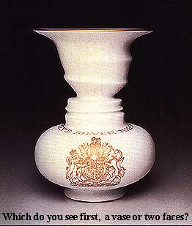
Ambiguous Figures
Face or Vase?
Notes:
illusions that deceive the human visual system into perceiving something that is not present or incorrectly perceiving what is present.
1596 - 1650 Descartes:
registration stage and an interpretation stage in the perceptual process.
Perceptual error or illusion may intrude at either of these two steps along the road to consciousness.
PHYSIOLOGICAL ILLUSIONS
is the what happens to the eyes as a result of prolonged stimulation. i.e. brightness, tilt, movement, color etc.
repetitive stimulation misleads the visual system in the early stages of visual processing.
COGNITIVE VISUAL ILLUSIONS
Exploits the predictive cues of early visual processing.
Misdirects in-built assumptions or knowledge while processing.

Slide 12
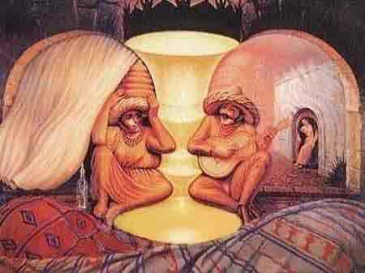
Notes:
THREE LINKS TO PERCEPTION
EXTERNAL / PHYSICAL
VISUAL APARATUS
INTERPRETATION OF STIMULUS

Slide 14
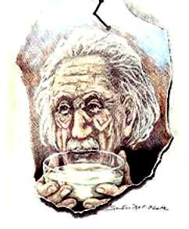

Slide 15
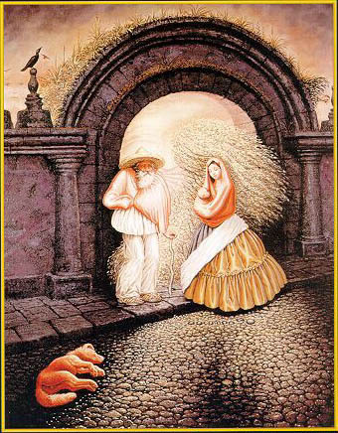

Slide 17
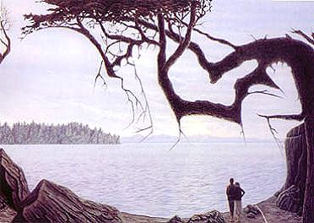

Slide 18
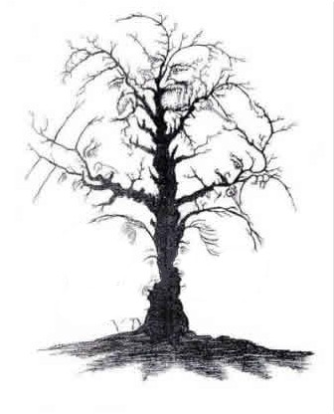

Slide 21
THE END

